Slide 1

ADVANCED EXCEL STATISTICS FOR BUSINESS ANALYTICS
Notes:
Welcome!

Slide 2

George Mount
Data Analyst & Educator at Stringfest Analytics
George works as an independent analyst and data analytics educator with the goal to help clients manage their data so they think more creatively. He serves as a technical expert and lead curriculum developer for Thinkful’s data analytics program and is the instructor of the DataCamp course “Survey and Measure Development in R.”
George blogs about data, innovation, and career development at georgejmount.com. He holds a master’s degree in information systems with a certificate of achievement in quantitative methods from Case Western Reserve University
Notes:
Here’s me, you already learned this.

Slide 3

COURSE OBJECTIVES
Model a causal relationship between multiple independent variables and a categorical or continuous dependent variable
Use simulation and optimization techniques to model business scenarios
Build and evaluate forecasts
Make compelling business recommendations using inferential statistics
Advanced Excel Statistics for Business Analytics
Notes:
OK, now that you have learned many of the building blocks of statistical inference we can really get into the applications. We will look at building predictive models, these models will let you do things like predict whether a customer will or won’t buy something.
We will also look at using Excel to model uncertainty by simulating an event many times and evaluating the results, and use optimization to find the best allocation of resources to achieve a given example.
Finally we will look at how to build basic forecasts using some different approaches and how to evaluate that forecast’s performance.
Again, I really want to keep the focus on take-home business applications. I hope that you feel confident using these methods in a business setting.

Slide 4

WHY WOULD WE DO THIS IN EXCEL?
“You get to look at the data every step of the way, building confidence while learning the tricks of the trade.”
-- John Foreman
Advanced Excel Statistics for Business Analytics
Notes:
With the rise of data science programming in R and Python it seems silly to want to do this in Excel but we can really get hands-on this way. We get a lot more up close and personal analysis of the data.

Slide 5
FOLLOWING ALONG
Each section is a sub-folder
Demos = follow along with me
Drills = try it yourself
Refresh your memory with the demo notes
Intermediate Excel Statistics for Business Analytics
Notes:
This is an Excel class, so we won’t be looking at PowerPoint the whole time – to follow along, you will see that all assets are divided by section.
Some of our Excel time will be Demos – for this I will be walking through some procedure in Excel.
If you need any datasets they will be included in each sub-folder.
Then there may be a Drill where you will work on it for yourself during some specified period of time.
I have provided written notes/instructions about the Demos which you can refer to while working on the Drills.

Slide 6
HAVE YOU INSTALLED THE DATA ANALYSIS TOOLPAK?
Notes:
Has everyone done this? If not, check the demo notes and/or follow along with the next two slides.
The steps are different for Mac versus Excel. Instructions on the next slide

Slide 7
ON WINDOWS: ON MAC:
File
Options
Add-ins
Go
Check on Analysis ToolPak
OK
Tools
Excel Add-ins
Check on Analysis ToolPak
Click OK
Notes:
Give me a thumbs up when everyone has this installed.
Open up the wages dataset, we will now summarize a continuous variable (wage) using the Analysis ToolPak.
Another reminder to use the demo notes.

Slide 8
1. REGRESSION ANALYSIS AND PREDICTIVE MODELS
Notes:
All right, let’s head to our first unit here on regressions. In the prior course in this series we learned how to model the relationship of one continuous variable on another. Now let’s see how to use multiple continuous variables to predict a continuous or binary variable.

Slide 9

Warm-up
File: mpg-warmup.xlsx
Calculate descriptive statistics and correlations for these variables
Draw scatterplots between mpg/weight, mpg/horsepower and mpg/displacement
There’s always room for descriptive statistics
Notes:
Let’s get started with a dataset containing car and mileage statistics. Take a few moments to refresh your memory on performing descriptive statistics in Excel.
While we may fall guilty to it for expedience, you should re-calculate descriptive statistics each time to encounter a new dataset! This is not optional work and you cannot jump to the inferential stuff just like you couldn’t jump to the middle of a story and really understand it – the descriptive statistics set the stage for the rest of the program.

Slide 10
MULTIPLE LINEAR REGRESSION
Notes:
OK, let’s get into multiple linear regression – you may have done linear regression with one variable but what about when you want to use multiple independent variables to predict one dependent variable?

Slide 11
EXPLICIT WARNING:
MATH AHEAD
Notes:
Brace yourselves! I want to show you the formula for the line that we are going to fit into our scatter plot.

Slide 12
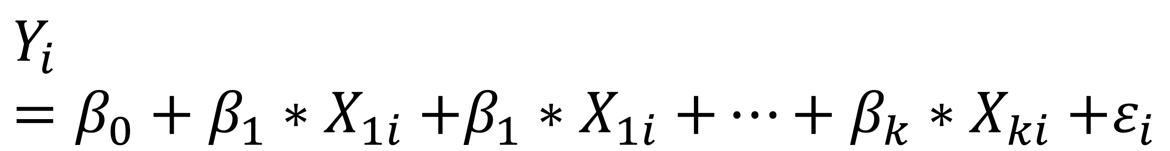
MULTIPLE REGRESSION EQUATION
Dependent / predictor variable
Independent / response variable(s)
Slope coefficient(s)
Y intercept
Error term(s)
$$Y_{i}=β_{0}+β_{1}{∗X}_{1i}+β_{1}{∗X}_{1i}+…+β_{k}{∗X}_{ki}+ε_{i}$$
Notes:
Again, we are predicting Y with a straight line. This line will have three components – first is going to be the y intercept. Then we will find a coefficient of the slope multiplied by our independent variable.
Then there will be some random error. This is the variation in the dependent variable that our independent variable doesn’t explain.
This time there are multiple variables.

Slide 13
HYPOTHESES
Ho: No relationship between X’s and Y. The slope equals zero.
Ha: A relationship between X’s and Y. The slope does not equal zero.
Notes:
Now, the hypotheses. Again, it’s all about this fitted line. If the slope of the line is equal to zero, we really can’t say how 1 unit of X influences Y.
Now, there is a series of steps, or an algorithm to use the fancy word, used to actually fit that line, but we will let Excel do it for us. And we will get something like the next slide.

Slide 14
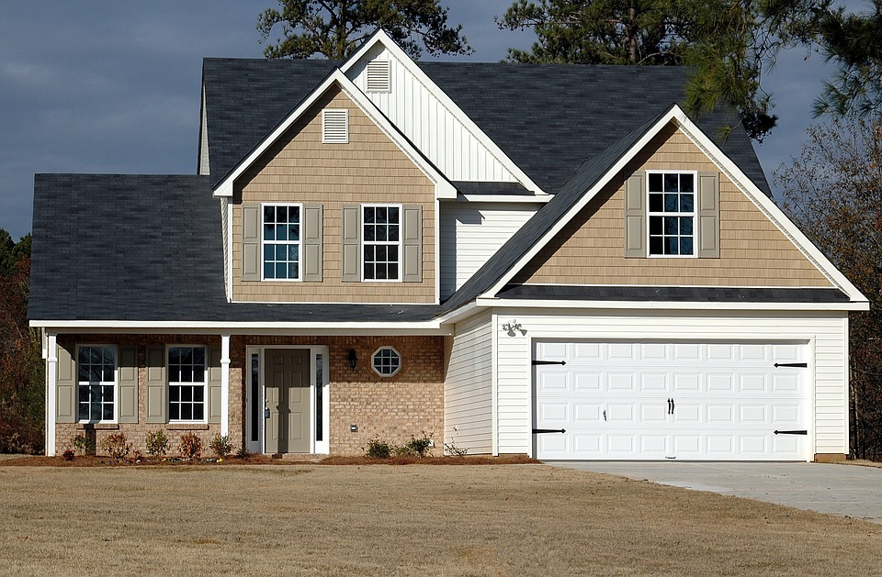

The acorn becomes the oak
How do we measure differences in time across same individuals?
Repeated measures
House at time 1
House at time 2
Intervention (install AC)
Notes:
OK, let’s take a look at another type of statistical test. In the last class we discovered that houses with AC have significantly higher average sales prices than those without.
A similar study would be to measure the sale price of homes without AC. Then install the AC. Then measure the sale price after the installation. This is called repeated measures because we are taking measures of the same observation at individual time points. There is often some intervention between the time points.
Now, in many settings, this is very difficult to conduct a repeated measures analysis, because it’s hard enough to measure these things once, let enough at multiple time points. Could you imagine buying a house, putting in AC, and then flipping it? That would be a very costly experiment with a lot of room for error.
But in some places like healthcare or education, where you are presenting new treatments or methods to your participants, and it’s likely you’ll be able to measure those participants at a later date, this is a common method.
So let’s get into one particular test related to repeated measures.

Slide 15
ASSUMPTIONS
Linear relationship between independent and dependent variables
No influential cases
Variance of residuals is constant
Values of residuals are normally distributed
No multicollinearity
Notes:
Explanations for each of these in the next slide.
For each of these methods we are using, I will present the assumptions. Assumptions matter and I tend to focus on them maybe more than other people do. It’s a matter of garbage-in, garbage-out. If you don’t meet the assumptions, you can’t rely on your results.
We won’t cover all of them for reasons of expediency, both due to time constraints and because some of them can be quite involved in calculate, especially in Excel. But here are the primary assumptions of linear regression. We will walk through each of these one at a time in the next slides.

Slide 16
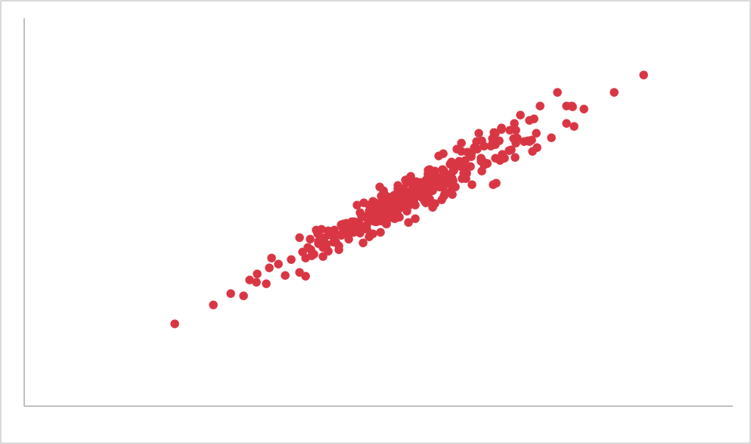
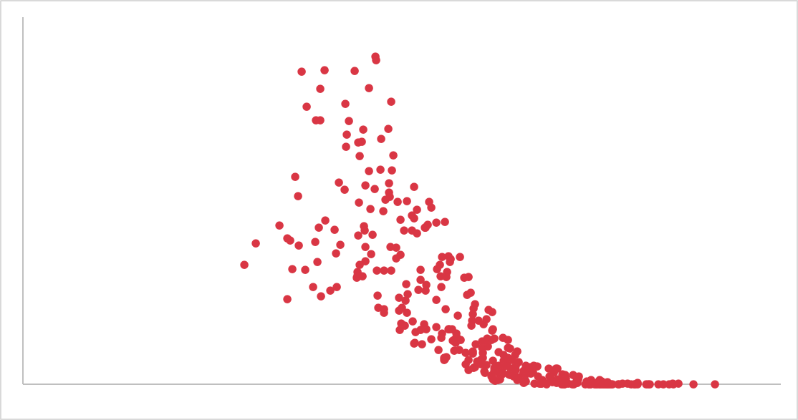
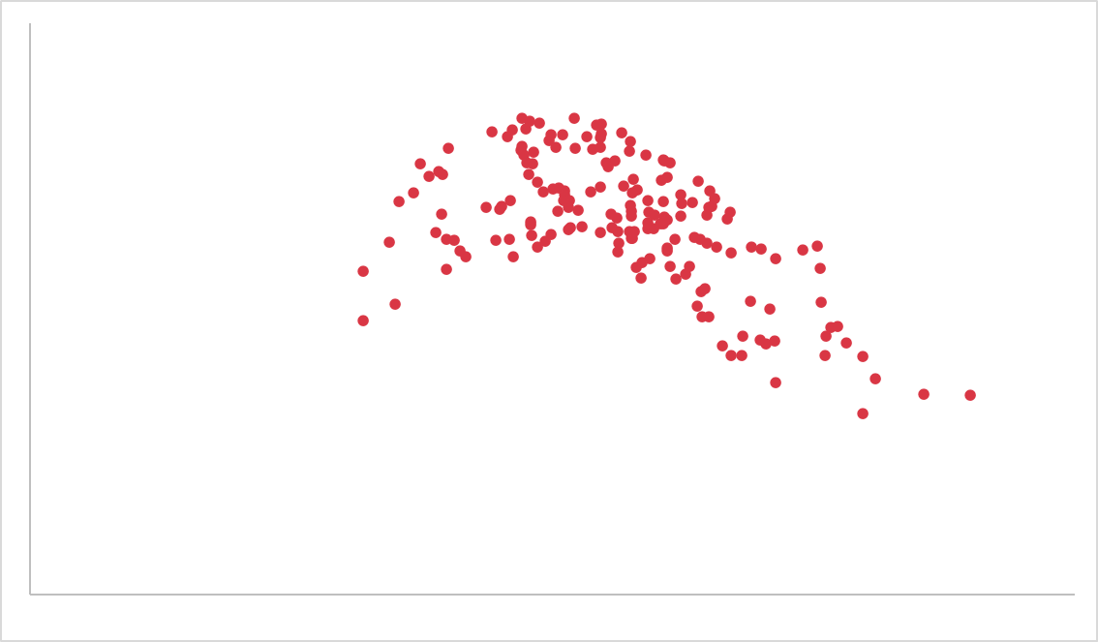


ASSUMPTIONS
Linear relationship between independent and dependent variables
Notes:
First, a linear relationship. Each of these are scatter plots of a relationship between X and Y. This relationship should be, well, linear, for linear regression to work.
That means a nice linear relationship like the first one can be modeled linearly, but the next two cannot.

Slide 17
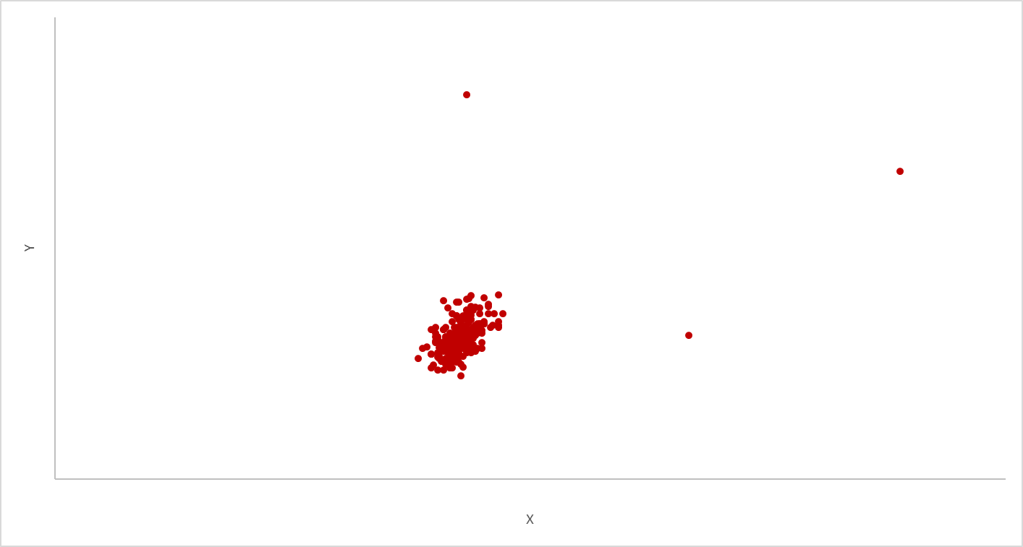
ASSUMPTIONS
No influential cases
Which of the below are actually influencing the line?
Notes:
We also want to check for cases that are unduly influencing the slope of our line. Remember that all we are doing with linear regression is fitting a line through our point to optimize some conditions.
You may notice that on this scatter plot there are some points that seem to be way off-kilter. We want to check whether any of these points are unduly changing the slope of our line. This is kind of a tricky thing to calculate in Excel so I will do it for you, but I want you to be aware of this important assumption.

Slide 18
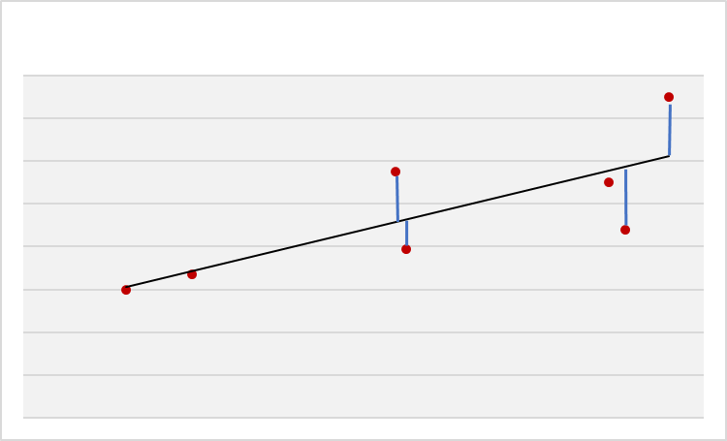
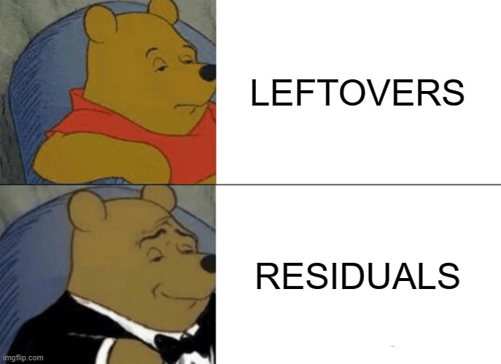
$$Residual=Y−\hat{Y}$$
Observed value
Estimated value
Notes:
OK, now I want to remind you what a residual is in linear regression. It’s basically a “leftover” of the the actual value from the estimated value, or the values on the slope of the line. This is important to keep in mind to understand this next residual.

Slide 19
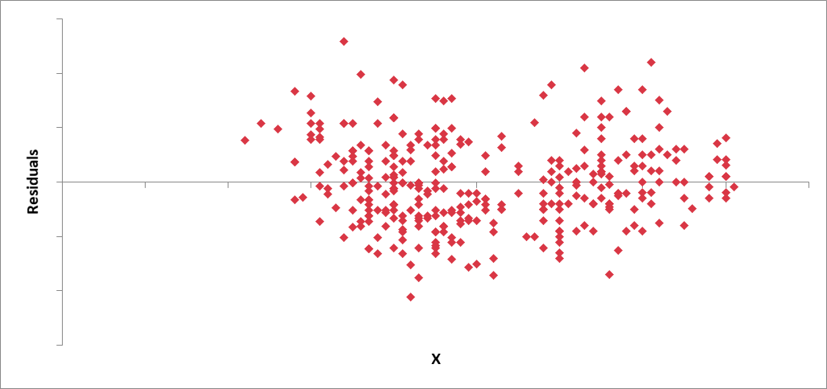
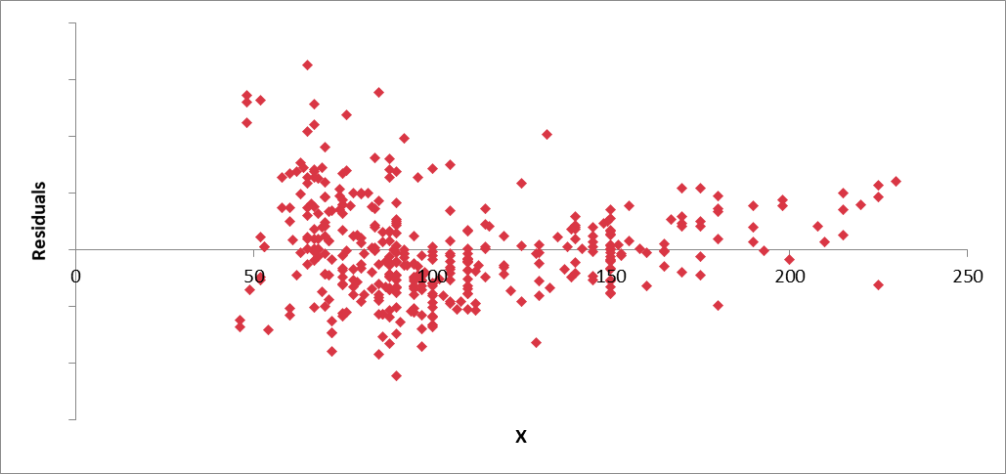
ASSUMPTIONS
Variance of residuals is constant
Notes:
Here I have taken all of those residuals, or leftovers and made them a scatterplot. The result should look very random, we should not see any kind of pattern, like the one on the left.
Notice that the one on the right, there are a bunch that are clumped over to the left, right? And then it gets tighter to the right. This tells us that the residual variance is not constant.
Like most things in statistics there are multiple ways to check for this assumption, but graphically is a good start.

Slide 20
DEMO
mpg-regression.xlsx
Is there a significant relationship of displacement, horsepower and weight to mpg?
Check assumptions: linearity, no influential cases, independence of residuals
Notes:
Let’s do it!

Slide 21
DRILL
penguins-linear.xlsx
Is there a significant relationship of culmen length, culmen depth and flipper length on body mass?
Check assumptions: linearity, no influential cases, independence of residuals
Unhide influential-cases worksheet when read. No peeking!
Notes:
Let’s do it!

Slide 22
MODEL DIAGNOSTICS: R-SQUARE
Regression model
How much % is explained here? This is r-square
Variability of Y
Error
This remains unexplained
Notes:
Great, now that you have used Excel to fit that line between X and Y, let’s take a couple of extra steps to interpret our model. We already saw from the p-value that the slope of our line is significantly different from zero. But this doesn’t tell us how much of Y is explained by X – for this, we will use r-square.
This goes back to the error term. Everything we can’t explain in y’s variability is error. The part we can explain is the R-square. R-square is based in a percentage amount. It’s there in our Excel output, so we’ll go back and interpret it.

Slide 23
ADJUSTED R-SQUARE AND MODEL PARSIMONY
How much is explained here? This is r-square
More variables = more explanation … and more bloat
Regression model
Variability of Y
Error
This remains unexplained
Notes:
Great, now that you have used Excel to fit that line between X and Y, let’s take a couple of extra steps to interpret our model. We already saw from the p-value that the slope of our line is significantly different from zero. But this doesn’t tell us how much of Y is explained by X – for this, we will use r-square.
This goes back to the error term. Everything we can’t explain in y’s variability is error. The part we can explain is the R-square. R-square is based in a percentage amount. It’s there in our Excel output, so we’ll go back and interpret it.

Slide 24
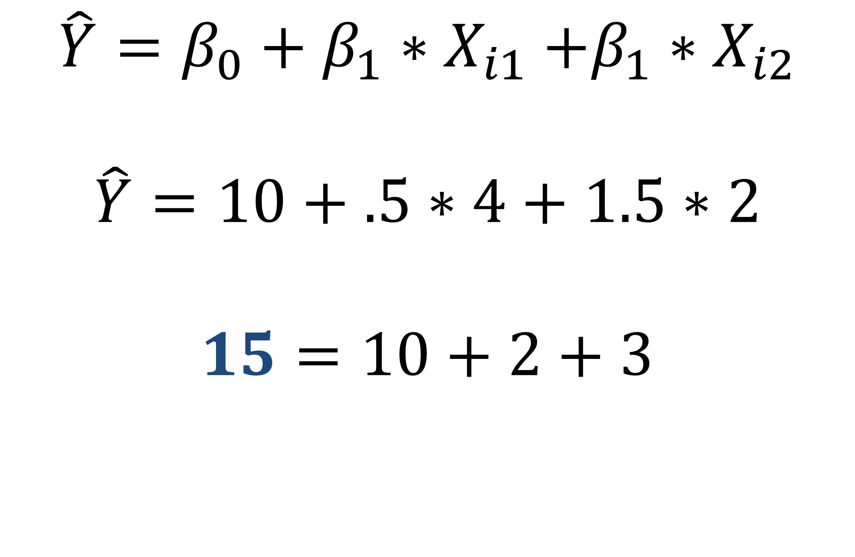
MAKING POINT PREDICTIONS
$$\hat{Y}=β_{0}+β_{1}{∗X}_{i1}+β_{1}{∗X}_{i2}$$
$$\hat{Y}=10+.5∗4+1.5∗2$$
$$15=10+2+3$$
Notes:
Another thing we can do is use our fitted line to predict values of Y given an X value. This predicted value is indicated as y-hat. So, here’s the equation of our fitted line. Let’s say our Y-intercept was fit to 10 and the slope is .5.
If our estimated value of X is 4, then our predicted value of Y is 12.

Slide 25
DEMO
mpg-regression-diagnostics.xlsx
What is the adjusted R-square of this model?
What is the expected MPG of a car weighing 3,000 pounds that has 200 horsepower?
Notes:
Let’s do it!

Slide 26
DRILL
penguins-linear-diagnostics.xlsx
What is the R-square of this model?
What is the expected body mass of a penguin with a flipper length of 200 mm?
Notes:
Let’s do it!

Slide 27
QUESTIONS?
Notes:
Any final questions?

Slide 28
INTERACTION TERMS
Notes:
Let’s take some time to look at what interaction terms do for us.

Slide 29

When IV’s conspire: interaction terms
High heat is uncomfortable
High humidity is uncomfortable
High heat * high humidity is even more uncomfortable
The effect of heat (IV) on discomfort (DV) is different at different values of humidity (another IV)
Notes:
An interaction term is when the effect of one independent variable on the dependent variable is different at different values of another independent variable, so let’s think of a real-world example here.
Generally the hotter things get, the more uncomfortable it is, and same with humidity. But high heat is even more uncomfortable at high levels of humidity and vice versa, right? There is an interaction term here.
So how are we going to model this? Let’s take a look on the next slide.

Slide 30
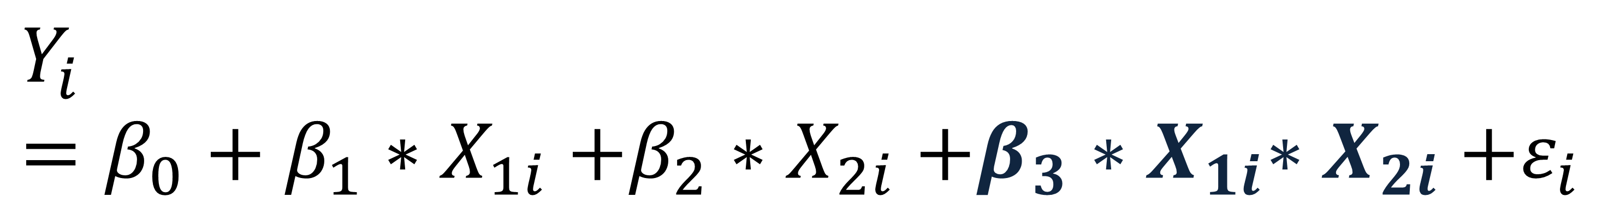
REGRESSION WITH INTERACTION
Dependent / predictor variable
Main effects
Interaction effect
Y intercept
Error term
$$Y_{i}=β_{0}+β_{1}{∗X}_{1i}+β_{2}{∗X}_{2i}+β_{3}{∗X}_{1i}{∗X}_{2i}+ε_{i}$$
Notes:
This looks pretty familiar right, we have our DV, our intercept and then our coefficients and X-values, but we also have an interaction term. We will multiply them together by a third coefficient. So it’s like we have a third component, but it is comprised of the product of the two other X-variables.

Slide 31
DEMO
airquality-interaction.xlsx
What is the effect of solar radiation and temperature on ozone? What about solar radiation * temperature?
Run the regression without the interaction term first (parsimony)
Notes:
Let’s take a look at an example of how we would do this in Excel.

Slide 32
DRILL
wine-interaction.xlsx
What is the influence of fixed and volatile acidity on pH? What about fixed * volatile?
Notes:
Now it’s your turn.

Slide 33
LINEAR REGRESSION WITH CATEGORICAL IV’S
Notes:
This is the chi-square test of independence. You will often see it as the Greek letter chi with the exponent 2 sign.

Slide 34
What is 2*USA? 4.5*Europe?
Linear regression assumes continuous independent variables
How can we use categorical variables?
We can encode them as a series of 0-1 values
Notes:
Linear regression assumes all of our variables are continuous, but what if we wanted to include categorical variables? We may for instance want to know if the country of origin affects the dependent variable. But we really can’t use them as-is, because it wouldn’t make sense to say that one country is lesser or greater than another, and it wouldn’t make sense to multiply these categories by a coefficient, i.e. double USA or 4.5 times Europe.
So we are going to have to hack a way to code these categories as a series of 0-1 values.

Slide 35
DUMMY-CODING
Sex | Height
Male | 72
Female | 67
Female | 62
Male | 74
Female | 71
Male | 68
Male | Female | Height
0 | 0 | 72
0 | 1 | 67
0 | 1 | 62
0 | 0 | 74
0 | 1 | 71
0 | 0 | 68
Notes:
The way that we are going to do this is with dummy-coding. So what we will do is take a categorical variable like Sex. We want to know if this has any influence on height. We can turn the two values of Sex into two columns and flag these as 0’s or 1’s.
For male, if we set them all at zero, and flag female as 1, we technically have a column of all 0’s, so often you won’t even see this column displayed, it’s our status quo. So let’s look at what the equations are for running a regression on data like this.

Slide 36

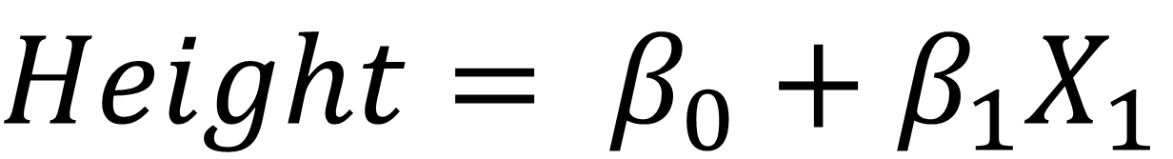
REGRESSION WITH DUMMIES
Sex | Height
Male | 72
Female | 67
Female | 62
Male | 74
Female | 71
Male | 68
Male | Female | Height
0 | 0 | 72
0 | 1 | 67
0 | 1 | 62
0 | 0 | 74
0 | 1 | 71
0 | 0 | 68
$Height= β_{0}+$ $β_{1}X_{1}$
$X_{1}$ = 1 when female; otherwise 0.
Notes:
Now we have our typical regression equation, and we have a variable for X1, so we will multiply that coefficient by 1 if female, otherwise it’s a 0. So it’s almost like we are flagging these intro true-false variables for each value a category can take.

Slide 37
DEMO
mpg-dummy.xlsx
Does the car’s origin have significant influence on its mileage?
What do we expect the mileage to be for each origin for a car weighing 3,000 pounds?
Notes:
Let’s do it!

Slide 38
DRILL
penguins-dummy.xlsx
Regress sex on height
Notes:
Let’s do it!

Slide 39
LOGISTIC REGRESSION
Notes:
This is the chi-square test of independence. You will often see it as the Greek letter chi with the exponent 2 sign.

Slide 40
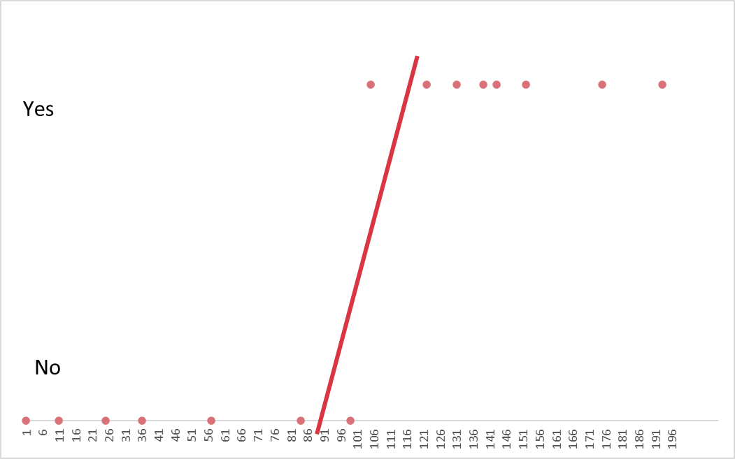
HOW DO YOU MODEL A BINARY OUTCOME?
Notes:
Ok, off to the assumptions like the other tests we’ve done. One is that there is a linear relationship between the variables, we had the same for correlation. Also, no influential cases. The other ones we won’t get into so much. They have to do with the residuals, which you will learn about in a bit.

Slide 41
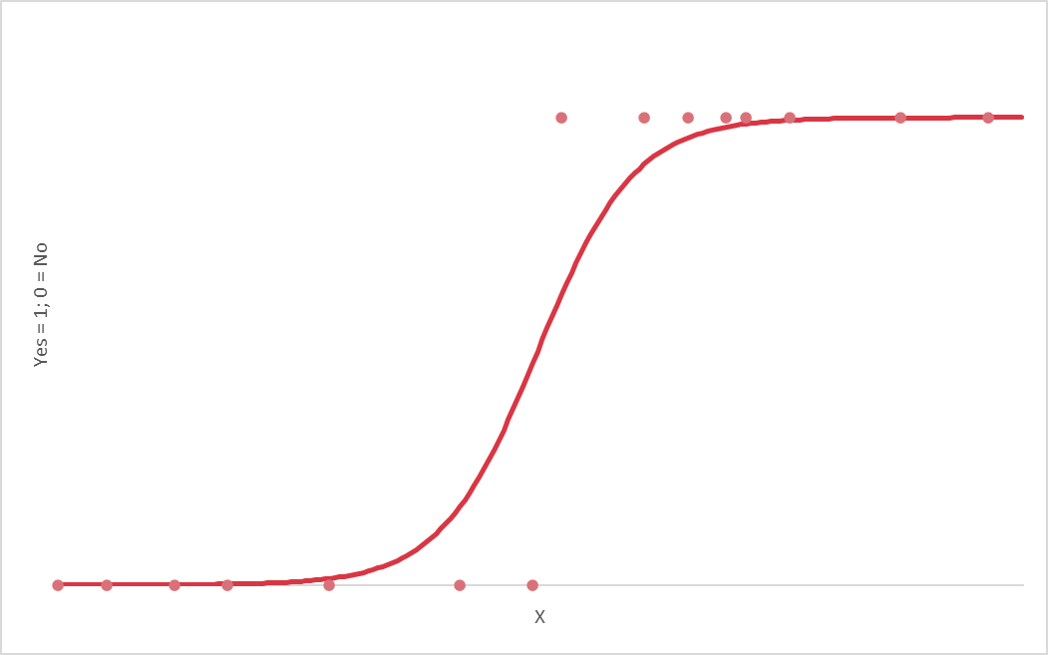
FITTING A BINARY OUTCOME: LIKE ANTS ON A LOGARITHM
Notes:
We are going to fit a sigmoid curve through the line, with some clever usage of logarithms, this line will run between 0 and 1, and we can use it to model the probability of whether a datapoint will be a 0 or a 1.

Slide 42
ASSUMPTIONS
Binary dependent variable
Observations are independent
Large sample size
Linearity of independent variables and log odds
No influential cases
No multicollinearity
Notes:
Most of these are pretty easy to test.

Slide 43

LOGISTIC REGRESSION EQUATION
Independent / response variable(s)
Y intercept
Slope coefficient(s)
Dependent / predictor variable
(expressed in probability)
$$P=\frac{e^{β0+ β1∗x1i+…+βk∗xki}}{1+e^{β0+ β1∗x1i+…+βk∗xki}}$$
Notes:
This time we are not predicting a continuous outome we are predicting a thing so this in terms of probability.
We’re not predicting a continuous variable anymore, we are predicting a probability. There are only two possible outcomes: 1 or 0.

Slide 44
HYPOTHESES
Ho: No relationship between X’s and Y. The Y values you predict are no closer to the actual Y values than you would expect by chance.
Ha: A relationship between X’s and Y. The slope does not equal zero. The Y values you predict are closer to the actual Y values than you would expect by chance.
Notes:
Actually a similar idea of a hypothesis than for linear regression.

Slide 45
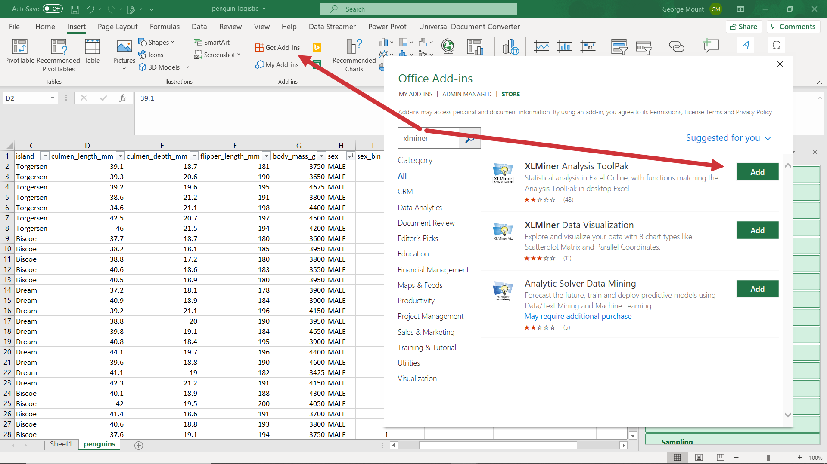
INSTALLING XLMINER
Notes:
You will need to install a new add-in for this, fortunately it is free and you can download it right from the Add-ins menu. So go to Insert -> Get Add-ins -> and XLMiner Analysis ToolPak.

Slide 46
DEMO
occupancy.xlsx
Is there a significant relationship of temperature, humidity and light to occupancy?
Notes:
OK, let’s try to predict whether we can predict occupancy.

Slide 47
DRILL
penguin-logistic.xlsx
Is there a significant relationship of culmen length, culmen depth, flipper length and body mass and sex?
Use the 0-1 sex_bin variable
Notes:
Now it’s your turn.

Slide 48
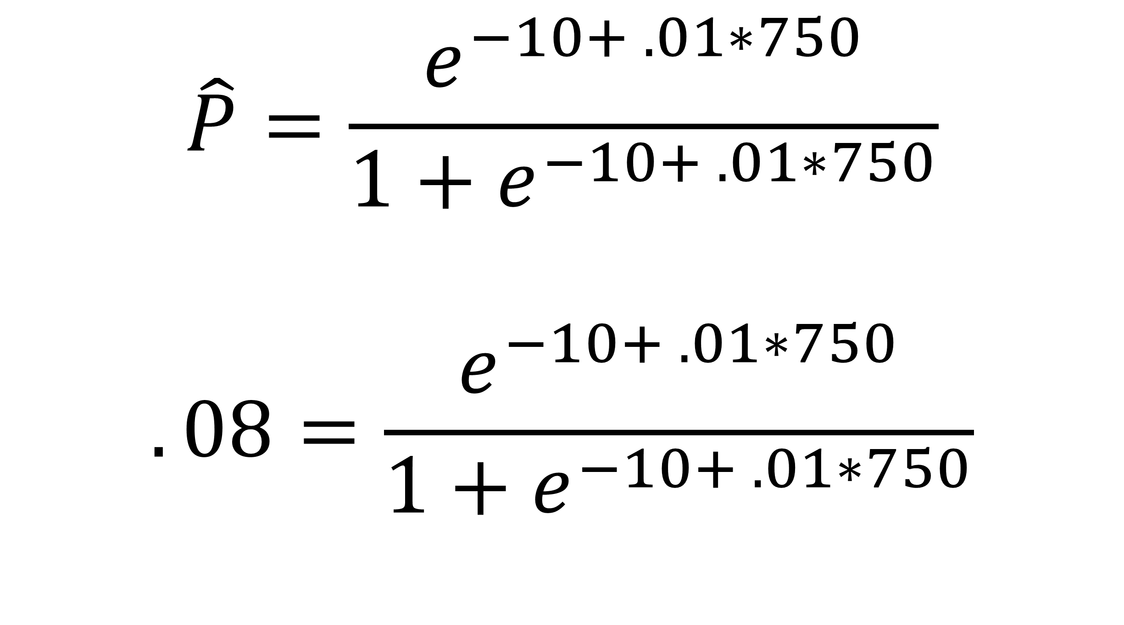
MAKING POINT PREDICTIONS
$$\hat{P}=\frac{e^{−10+ .01∗750}}{1+e^{−10+ .01∗750}}$$
$$.08=\frac{e^{−10+ .01∗750}}{1+e^{−10+ .01∗750}}$$
Notes:
We can make predictions and get the results in probability terms.

Slide 49
% PREDICTIVE ACCURACY
Actual | Predicted % chance | Predicted | Predicted right?
0 | 8.00% | 0 | TRUE
0 | 68.56% | 1 | FALSE
1 | 47.13% | 0 | FALSE
0 | 31.08% | 0 | TRUE
0 | 73.63% | 1 | FALSE
0 | 27.96% | 0 | TRUE
0 | 7.59% | 0 | TRUE
0 | 89.61% | 1 | FALSE
0 | 19.36% | 0 | TRUE
1 | 61.49% | 1 | TRUE
Notes:
Diagnosing the performance of logistic regression is a little different than linear regression. There are lots of ways to do this. Here is a very simple one. Basically we will get that probability result, if it’s less than 50% then we assume it’s a no, otherwise it’s a yes. We can count up how many we got right. In this case there are 10 observations, three are incorrect, it’s 70%.
This is quite simplistic but a start.

Slide 50
DEMO
occupancy-diagnostics.xlsx
Do we predict that a room with temperature 25, humidity 30 and light 400?
What is the predictive accuracy of our dataset?
Notes:
OK, let’s go a little further in diagnosing this model. We will find out what the predictive accuracy is and we will make a point prediction.

Slide 51
DRILL
penguin-logistic-diagnostics.xlsx
Do we predict that a penguin with a culmen length of 40 mm and a flipper length of 175 mm is male or female?
What is the predictive accuracy of our dataset?
Notes:
Now it’s your turn.

Slide 52
QUESTIONS?
Notes:
Any questions on logistic regression?

Slide 53
2. OPTIMIZATION AND SIMULATION
Notes:
OK. This section will be a little different. We will use Excel to optimize results given constraints, and then simulation to see what happens if we do an uncertain thing many, many times. Let’s get started.

Slide 54
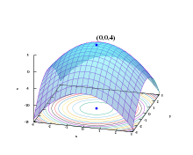
OPTIMIZATION: GETTING THE MOST BANG FOR YOUR BUCK
https://en.wikipedia.org/wiki/Mathematical_optimization
Notes:
Optimization is something that you may do consciously or not all the time. Often times in life we only have a certain amount of inputs, and we want to allocate those inputs to get the most amount of output. So let’s look at how to use Excel to model optimal outcomes.

Slide 55
DEMO
File: grades.xlsx
“What grade do I need on the final to get an A for the class?”
Use Goal Seek
Notes:
I am going to use the US grading system for an example that we may all have encountered in life which is to figure out what grade we need to do. Again if we know we can get a certain grade

Slide 56
DRILL
File: sales-price.xlsx
How many doo-hickeys do you need to sell to raise $1,000?
Notes:
Now it’s your turn. Warning that you may get a surprise result here.

Slide 57

Limitations of Goal Seek
No constraints
Inputs must be integers
Inputs must not exceed a given amount
No max/min objectives
Maximize profits given a mix of resources and costs
Minimize distance traveled given a route of stops
Notes:
So there are some issues here.

Slide 58
HAVE YOU INSTALLED THE SOLVER ADD-IN?
Notes:
Has everyone done this? If not, check the demo notes and/or follow along with the next two slides.
The steps are different for Mac versus Excel. Instructions on the next slide

Slide 59
ON WINDOWS: ON MAC:
File
Options
Add-ins
Go
Check on Solver Add-in
OK
Tools
Excel Add-ins
Check on Solver Add-in
Click OK
Notes:
Give me a thumbs up when everyone has this installed.
Open up the wages dataset, we will now summarize a continuous variable (wage) using the Analysis ToolPak.
Another reminder to use the demo notes.

Slide 60
DEMO
File: product-mix.xlsx
How many units of Product A and Product B should we produce to maximize revenue, given the amount of materials we have?
Use Solver
Notes:
Now let’s build a more sophisticated model here

Slide 61
DRILL
File: unit-production.xlsx
How many units of Product A and Product B should we produce to maximize revenue, given the available labor, parts and shipping units?
Integer constraint: You can’t produce a quarter of a unit!
Notes:
Let’s do it!

Slide 62
QUESTIONS?
Notes:
Questions on optimization? That was a cursory overview, and it doesn’t have to do as much with statistics, really it’s more about algebra and systems of equations. But I think it’s good to know a bit about optimization methods since much of statistics is powered by them.
For example if you can remember the line fitting it’s about optimization.

Slide 63
DEMO
File: solver-regression.xlsx
Fit a regression line using Solver
Minimize the sum of squared errors
Notes:
Now let’s build a more sophisticated model here

Slide 64

SIMULATION: WHEN IN DOUBT, PLAY IT OVER AND OVER ON A COMPUTER
Notes:
In many business cases you don’t exactly know what is going to happen right? You may know from prior patterns or sophisticated guesswork that you may sell X units a day, but you don’t exactly know, and there may be other contingencies where you can’t perfectly plan for the future.
Simulation is great for this. Basically what we can do is

Slide 65
Pick a number, any number (following the distribution)…
Demo: inverse-distribution.xlsx
What is the “inverse” of a probability distribution?
Notes:
So there are some issues here.

Slide 66
DEMO
widget-sales.xlsx
Our goal is to sell $10,000.
Sales follow a normal distribution of $1,000 a day on average with a standard deviation of $300.
How many days can we expect it to take to sell to $10,000?
Notes:
All right, here is the scenario. We want to figure out how long it will take us to sell 100 widgets given some basic statistics. We will simulate over and over how long it takes.

Slide 67
DEMO
monte-carlo.xlsx
Sales follow a normal distribution of $7,500 with a standard deviation of $1,500.
Fixed costs always equal $2,000.
Variable costs follow a normal distribution of $3,000 with a standard deviation of $1,000.
Run 1,000 simulations based on these statistics. What percent of time is a loss expected?
Notes:
Now it’s your turn to get an idea of how often we might expect a loss, given these business statistics.

Slide 68
QUESTIONS?
Notes:
Any final questions?

Slide 69
3. TIME SERIES AND FORECASTING
Notes:
All right, now we will do some basic forecasting.

Slide 70
“I have seen the future and it is very much like the present, only longer.” –Kehlog Albran, The Profit
“Forecasting is the art of saying what will happen, and then explaining why it didn’t.” --Anonymous
Notes:
Really we want to figure out what’s happened and extrapolate, forecasting always does that. Or to figure out what’s changed.

Slide 71
How do we try to predict the future?
Qualitative: surveys, market research
Quantitative:
Just use last period’s value (“naïve”)
Take a rolling average of the last X months
Assign heavier weight to more recent data points and smaller weight to less recent data points (exponential smoothing)
Notes:
There are many ways to predict the future here are some of them.

Slide 72
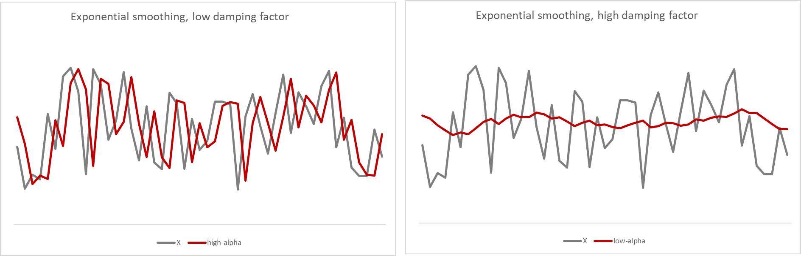
Exponential smoothing: damping factors
More weight to more recent data points, less to past
Less weight to more recent data points, more to past
Notes:
We will focus on doing exponential smoothing. For this we are seeing this looks like a pretty random so we want to figure out whether it helps us to go back in the past or not.

Slide 73
How do we know if we’ve predicted the future well?
Mean absolute error (MAE)
Root mean squared error (RMSE)
Mean absolute percentage error (MAPE): what is the absolute percentage error (actual <> forecast) of an observation on average?
Notes:
Again we want to try to measure everything we do in statistics often from different angles.
Now there are many ways to evaluate how well a forecast is doing against actual – we will use this one called MAPE.

Slide 74
DEMO
sp500.xlsx
What is the MAPE of
a naïve forecast?
a four-day rolling-average forecast?
an exponential smoothing forecast with a 20% damping factor?
Can we do any better on damping factor?
Notes:
OK let’s try to forecast S&P500 returns.
You will see why I wanted you to learn optimization first before doing this!

Slide 75
DEMO
female-births.xlsx
What is the MAPE of
a naïve forecast?
a four-day rolling-average forecast?
an exponential smoothing forecast with a 20% damping factor?
Can we do any better on damping factor?
Notes:
Now it’s your turn.

Slide 76
QUESTIONS?
Notes:
Any final questions?

Slide 77
4. CONCLUSION
Notes:
All right, we are at the end of our whirlwind tour! Here is some future learning for you and some things to check out on the O’Reilly learning platform.

Slide 78
Future learning
Statistical programming with R
Further exploratory data analysis & data preparation
Outlier detection, treatment and removal
Handling missing values
Dimensionality reduction
Forecasting for trends and seasonality
Notes:
I would suggest it’s time to learn a bit of R. It is going to make your workflow much easier.
However you can learn so much from mucking around in Excel and experimenting with statistical concepts. I have learned way more about probability and statistics through this than by learning how to code in R. But coding in R makes executing on this knowledge a ton easier.

Slide 79
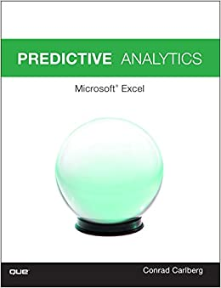
Predictive Analytics: Microsoft Excel, by Conrad Carlberg
On O’Reilly Learning at https://learning.oreilly.com/library/view/predictive-analytics-microsoft/9780134682921/
Human Centered Design • MDLS 2020
Notes:
This book will teach you some more advanced regression and forecasting techniques.

Slide 80
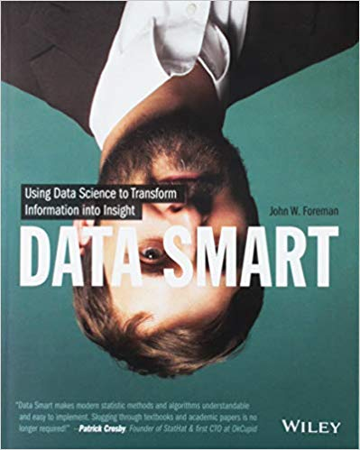
Data Smart: Using Data Science to Transform Information into Insight,
by John Foreman
On O’Reilly Learning at https://learning.oreilly.com/library/view/data-smart-using/9781118661468/
Human Centered Design • MDLS 2020
Notes:
This is a more “modern” approach to statistical analysis in Excel and will show you techniques like clustering, naïve Bayes, and things that you might not have thought possible in Excel, but again by learning them in Excel you get a really hands-on look at how these algorithms work that you may not necessarily get in R or Python (I quoted from this book way at the beginning in explaining why we would want to learn this stuff in Excel!)
The final chapter of this book does show you how to move into R from spreadsheets which is not a bad idea when you want to “productionize” what you have learned, but spreadsheets are really an awesome learning tool.

Slide 81
LET'S TALK
LINKEDIN
linkedin.com/in/gjmount
EMAIL ADDRESS
george@stringfestanalytics.com
WEBSITE
stringfestanalytics.com
GITHUB
github.com/summerofgeorge
Notes:
Thanks for coming! Feel free to contact me anytime, find me on LinkedIn, I also write frequently on this stuff so check out my website too.

Slide 82
QUESTIONS?
Notes:
Any final questions?

